Slide 1
REPRODUCTIVE HEALTH PROBLEMS AND STRATEGIES

Slide 2
REPRODUCTIVE HEALTH
According to WHO , “ It means a total well
being in all aspects of reproduction :
physical ,emotional, behavioral & social.”

Slide 3
TERMS RELATED TO REPRODUCTIVE HEALTH
AMNIOCENTESIS
CONTRACEPTION
MTP
STDs
INFERTILITY

Slide 4
Amniocentesis
Amniocentesis is a procedure in which amniotic fluid is removed from the uterus for testing or treatment.
Amniotic fluid is the fluid that surrounds and protects a baby during pregnancy. This fluid contains fetal cells and various proteins.
Although amniocentesis can provide valuable information about your baby's health, it's important to understand the risks of amniocentesis — and be prepared for the results.
In 1930 Thomas Orville Menees, J. Duane Miller, and Leland E. Holly were the first to perform an amniocentesis.

Slide 5
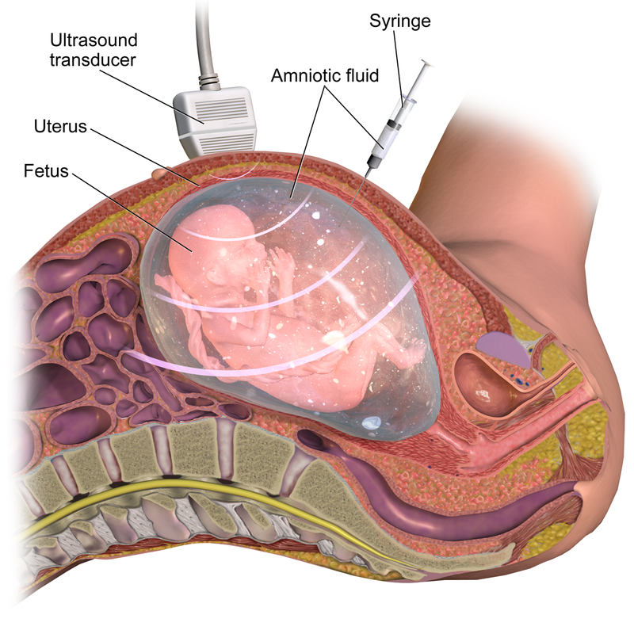

Slide 6
Why it's done?
Genetic testing. Testing it for certain conditions, such as Down syndrome.
Fetal lung testing. Testing it to determine whether a baby's lungs are mature enough for birth.
Diagnosis of fetal infection. The procedure can also be done to evaluate the severity of anemia in babies who have Rh sensitization — an uncommon condition in which a mother's immune system produces antibodies against a specific protein on the surface of the baby's blood cells.
Paternity testing. Amniocentesis can collect DNA from the fetus that can then be compared to DNA from the potential father.

Slide 7
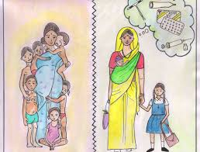
?

Slide 8
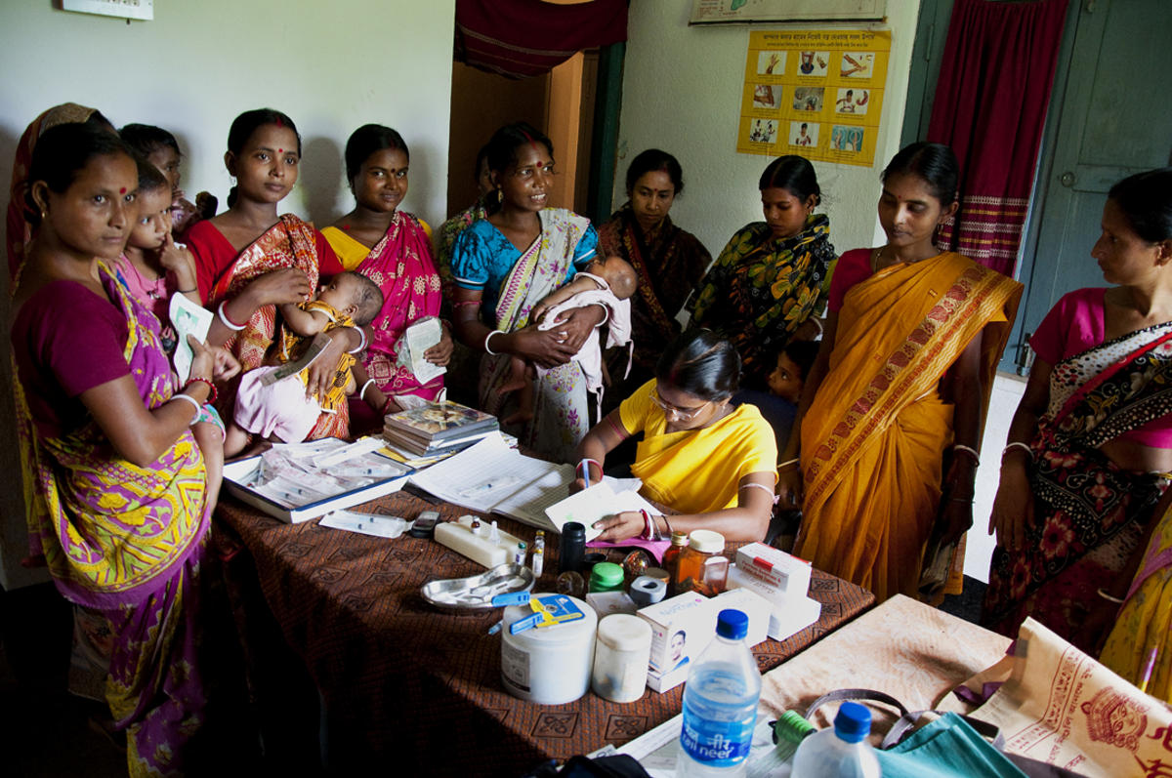

Slide 9
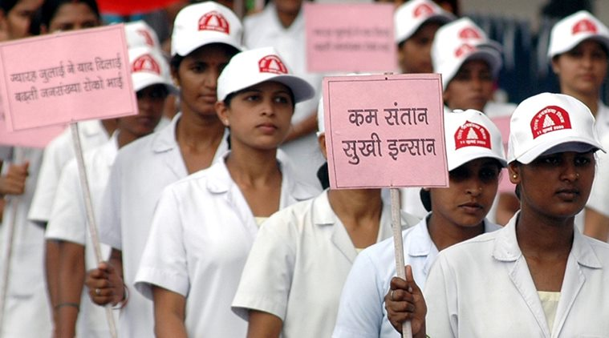

Slide 11
Family planning
1.NATURAL METHODS: AVOIDS MEETING OF SPERM & OVUM.
This method includes
A.Periodic abstinence - avoid coitus from day 10 – 17 of menstrual cycle when ovulation is expected. because chances of fertility is very high during this period, hence known as fertile period.
B.Withdrawal or coitus interuptus - male partner withdraws his penis from vagina before ejaculation avoiding insemination of sperms

Slide 12
CONT….
C.Lactational amenorrhea-absence of menstrual cycle during first six months of intense lactational period.
2.BARRIER METHODS:
A.CONDOMS - thin rubber used to cover penis in male or vagina & cervix in females.
B. DIAPHRAGMS, CERVICAL CAPS & VALUTS are all barriers for females to cover cervix during coitus.

Slide 13
Family planning tools

Slide 14
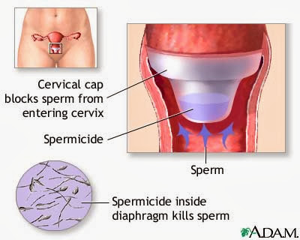
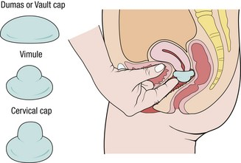

Slide 15
ADVANTAGES OF BARRIER METHODS:
1. They are disposable.
2. They can be self –inserted.
3. They are reusable.
4. Prevents conception by blocking entry of sperm thru cervix.

Slide 16
3. INTRA UTERINE DEVICES (IUD’S):
Devices inserted by doctors or nurses in uterus thru vagina. It includes
CU T, CU7, MULTILOAD 375, LIPPES LOOP.
Cu ions released suppress sperm motility & fertilizing capacity of sperms.
• Hormone releasing IUDs(Progestasert, LNG-20) makes the uterus unsuitable for implantation.
IUDs increase phagocytosis of sperms within the uterus.
The hormone releasing IUDs, in addition, make the uterus unsuitable for implantation and the cervix hostile to the sperms.

Slide 17
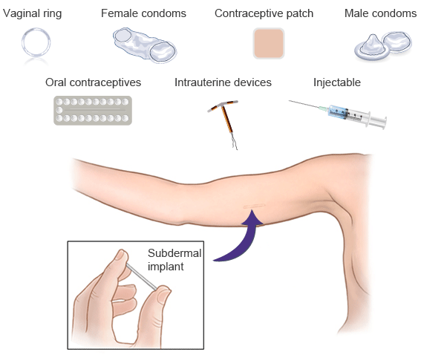

Slide 18
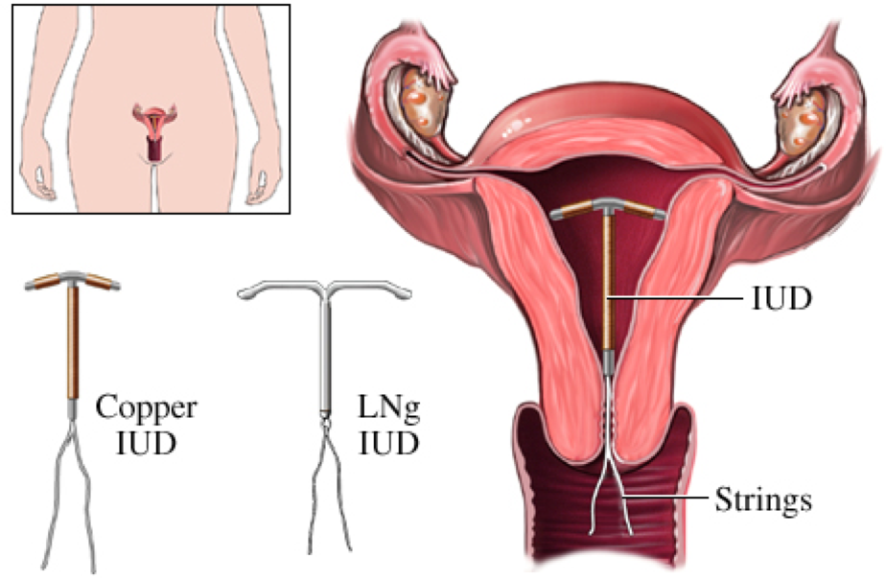

Slide 20
ORAL PILLS:
Pills are taken daily for 21 days.
They are very effective with less side effects.
Saheli - new oral contraceptive contains a non-steroidal preparation.
It is a ‘once a week ‘pill with high contraceptive value.
Injection or implantation of progesterone /estrogen under the skin.
They inhibit ovulation and implantation as well as alter the quality of cervical mucus to prevent/ retard entry of sperms.

Slide 21
CON……
Progestogens alone or in combination with estrogen can also be used by females as injections or implants under the skin.
Their mode of action is similar to that of pills and their effective periods are much longer.
Administration of progestogens or progestogen-estrogen combinations or IUDs within 72 hours of coitus.
Very effective as emergency contraceptives as they could be used to avoid possible pregnancy due to rape or casual unprotected intercourse.

Slide 22
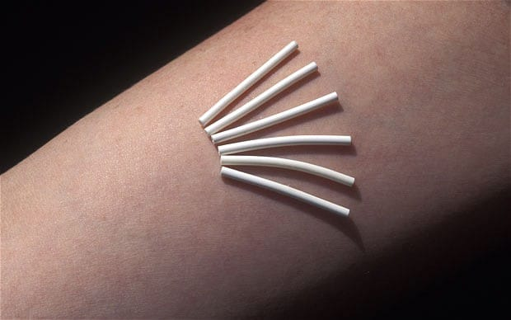

Slide 24
SURGICAL METHOD:
This method is also called as sterilisation.
It is advisable for male/female partner as a terminal method to prevent any more pregnancies.
In male, they’re called vasectomy, where the vas deferens is cut or tied.
In female, it is called tubectomy, where a small part of the fallopian tube is cut or tied up.
This method is highly effective but their reversibility is very poor.

Slide 25
vesectomy

Slide 26
tubectomy

Slide 27
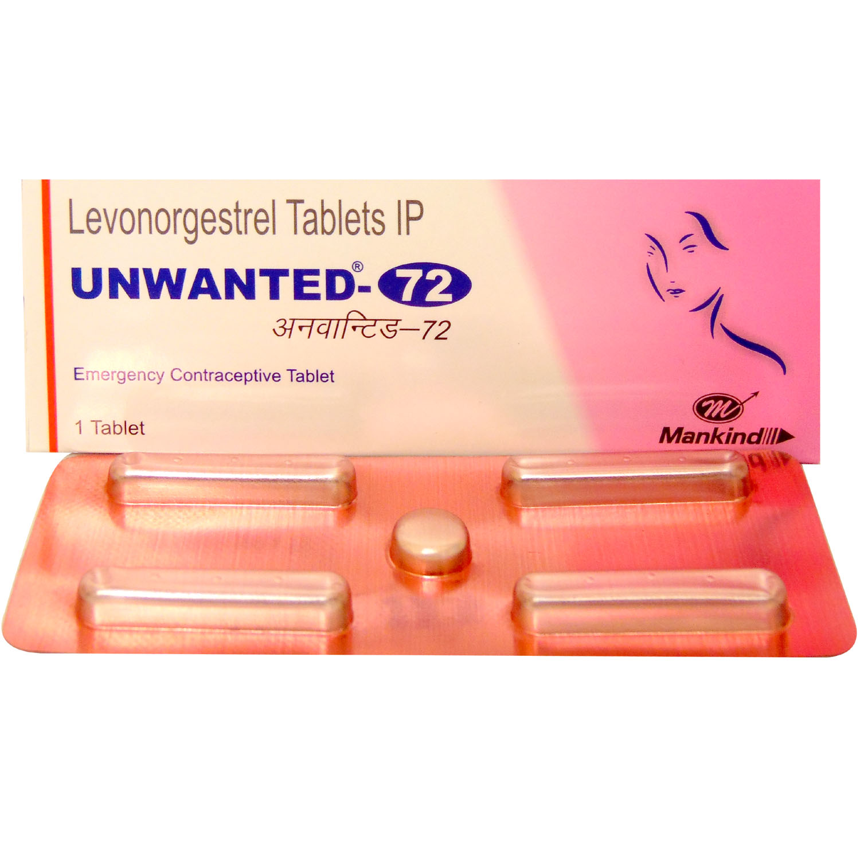

Slide 28
SIDE EFFECTS OF CONTRACEPTIVE METHOD:
It is very important that the selection of contraceptive method should be taken under the consultation of the doctors.
However, their possible ill-effects like nausea, abdominal pain, breakthrough bleeding, irregular menstrual bleeding or even breast cancer.
These symptoms should not be totally ignored.

Slide 29
WHAT IS MTP?
Intentional or voluntary termination of pregnancy before full term is called medical termination of pregnancy (MTP) or induced abortion.
Government of India legalised MTP in 1971 with some strict conditions to avoid its misuse.
WHY MTP?
MTP is done to get rid of unwanted pregnancies due to casual unprotected intercourse or failure of the contraceptive used during coitus or rape.
MTPs are also essential in certain cases where continuation in pregnancy could be harmful or even fatal to the mother or to the foetus or both.
MTPs are safe during the first trimester, i.e., upto 12 weeks of pregnancy. Second trimester abortions are much more riskier.

Slide 30
What is infertility?
Most experts define infertility as not being able to get pregnant after at least one year of trying. Women who are able to get pregnant but then have repeat miscarriages are also said to be infertile.
Pregnancy is the result of a complex chain of events. In order to get pregnant:
A woman must release an egg from one of her ovaries (ovulation).
The egg must go through a fallopian tube toward the uterus (womb).
A man's sperm must join with (fertilize) the egg along the way.
The fertilized egg must attach to the inside of the uterus (implantation).

Slide 31
What is assisted reproductive technology (ART)?
Assisted reproductive technology (ART) is a term that describes several different methods used to help infertile couples.
ART involves removing eggs from a woman's body, mixing them with sperm in the laboratory and putting the embryos back into a woman's body.

Slide 32
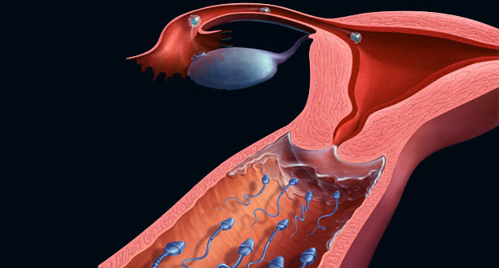

Slide 33
ART (ASSISTED REPRODUCTIVE TECHNOLOGY )
IVF-ET: in vitro fertilisation and embryo transfer.
GIFT : gamete intra fallopian transfer
ZIFT : zygote intra fallopian transfer
IUI: intrauterine insemination
ICSI : intra cytoplasmic sperm injection

Slide 34
IVF
Subhash Mukhopadhyay :(16 January 1931 – 19 June 1981) was a physician from Hazaribagh, Bihar (now in Jharkhand).
India, who created the world's second and India's first child using in-vitro fertilisation, Durga who was born 67 days after the first IVF baby in United Kingdom.
In 3 October 1978 Kanupriya Aggarwal was Born.
Unfortunately, Dr. Subhash Mukhopadhyay was harassed by the state government, and not allowed to share his achievements with the international scientific community.
He committed suicide on 19 June 1981.
His life and death has been the subject of countless newspaper reviews and inspired the Hindi movie Ek Doctor Ki Maut (Death of a physician), directed by Tapan Sinha.

Slide 35
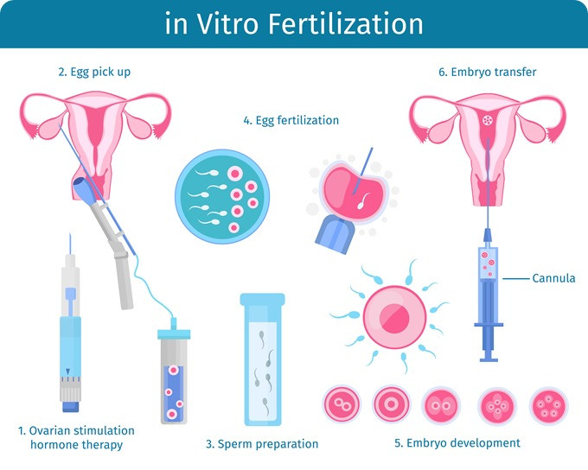

Slide 36
In vitro fertilization (IVF)
In vitro means fertilization outside of the body.
It is often used when a woman's fallopian tubes are blocked or when a man produces too few sperm.
Doctors treat the woman with a drug that causes the ovaries to produce multiple eggs.
Once mature, the eggs are removed from the woman.
They are put in a dish in the lab along with the man's sperm for fertilization.
After 3 to 5 days, healthy embryos are implanted in the woman's uterus.

Slide 37
Zygote intrafallopian transfer (ZIFT)
ZIFT or Tubal Embryo Transfer is similar to IVF.
Fertilization occurs in the laboratory.
Then the very young embryo is transferred to the fallopian tube instead of the uterus.

Slide 38
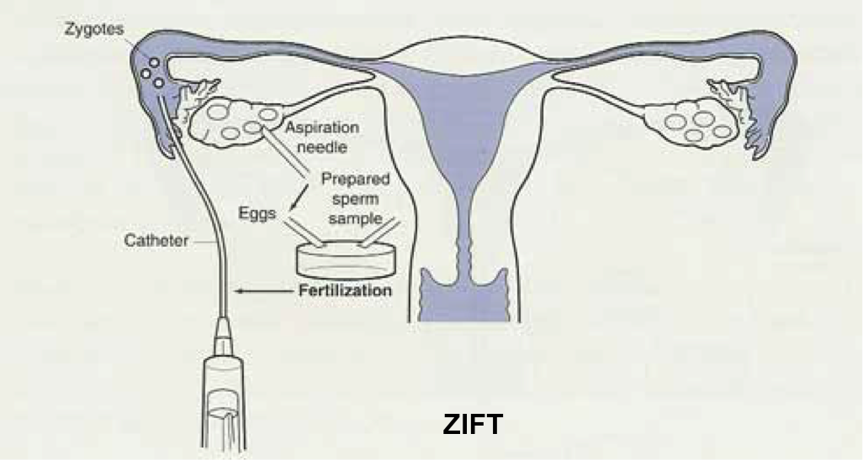

Slide 39
Gamete intrafallopian transfer (GIFT)
IT involves transferring eggs and sperm into the woman's fallopian tube.
So fertilization occurs in the woman's body.

Slide 40
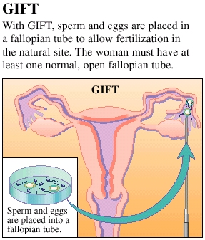

Slide 41
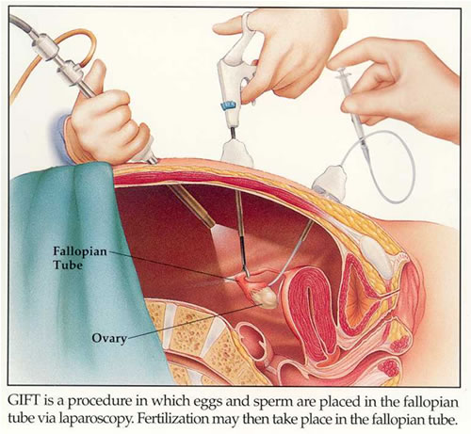

Slide 42
Intracytoplasmic sperm injection (ICSI)
IT is often used for couples in which there are serious problems with the sperm.
Sometimes it is also used for older couples or for those with failed IVF attempts.
In ICSI, a single sperm is injected into a mature egg.
Then the embryo is transferred to the uterus or fallopian tube.

Slide 43
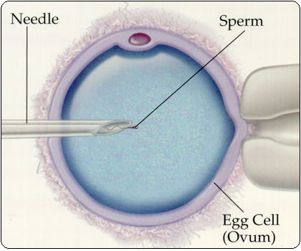

Slide 44
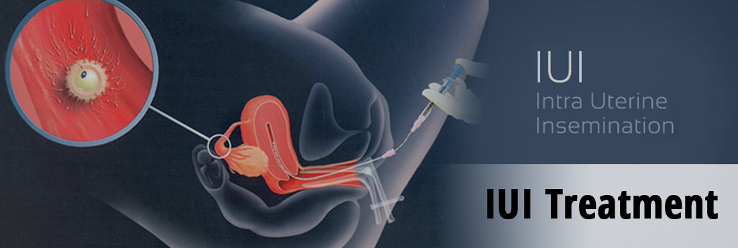

Slide 47
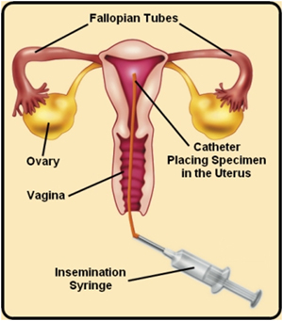

Slide 48
ART
ART procedures sometimes involve the use of donor eggs (eggs from another woman), donor sperm, or previously frozen embryos.
Donor eggs are sometimes used for women who can not produce eggs.
Also, donor eggs or donor sperm is sometimes used when the woman or man has a genetic disease that can be passed on to the baby

Slide 49
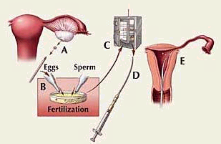

Slide 53
STD In women
No symptoms
Discharge (thick or thin, milky white, yellow, or green leakage from the vagina)
Vaginal itching
Vaginal blisters or blisters in the genital area (the region covered by underwear)
Vaginal rash or rash in the genital area
Burning urination
Painful urination
Pain during intercourse

Slide 55
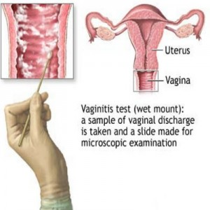

Slide 56
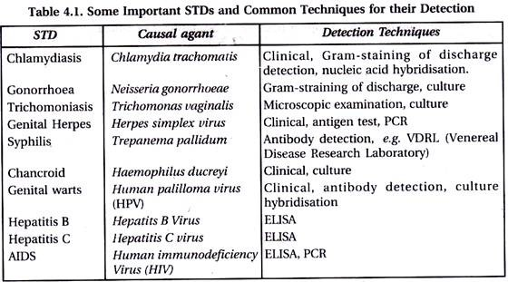

Slide 57
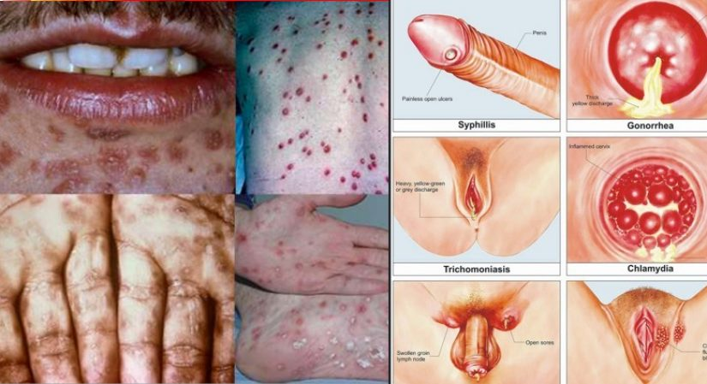

Slide 58
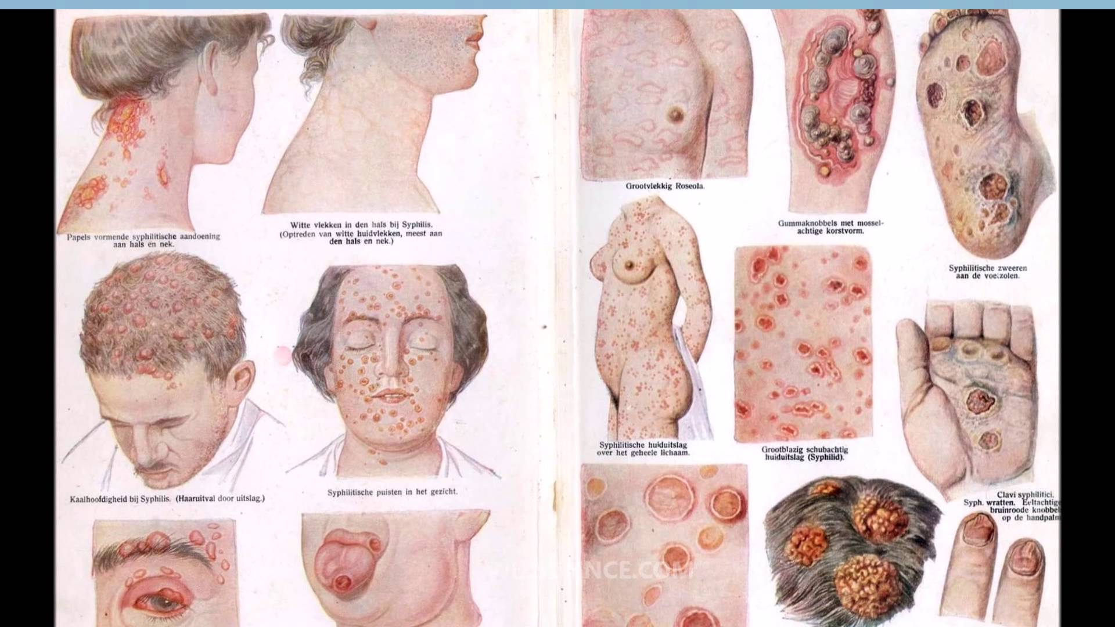

Slide 59
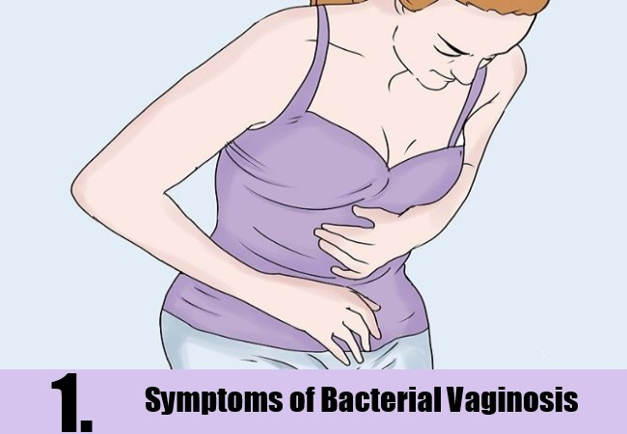

Slide 60
Bacterial vaginosis (BV)
Bacterial vaginosis (BV) is a disease of the vagina caused by excessive growth of bacteria with Gardnerella vaginalis.
Common symptoms include increased vaginal discharge that often smells like fish. The discharge is usually white or gray in color. Burning with urination may occur. Itching is uncommon. Occasionally, there may be no symptoms.
It also increases the risk of early delivery among pregnant women

Slide 61
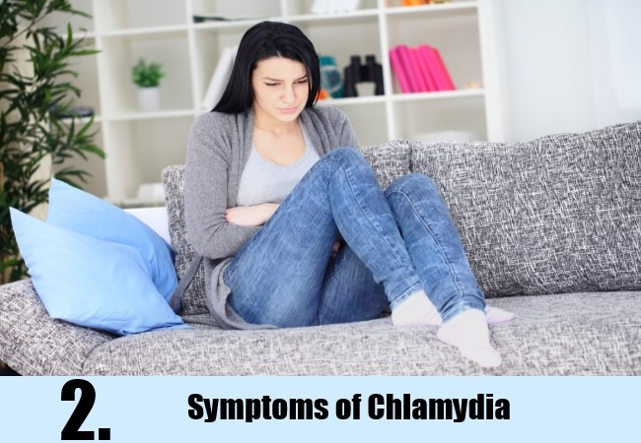

Slide 63
chlamydia symptoms
When chlamydia symptoms do appear, they typically present themselves 1-3 weeks after exposure to the bacteria.
For women, symptoms may include an abnormal vaginal discharge or a painful or burning sensation during urination. If the infection spreads, women can experience abdominal and pelvic pain, fever, nausea, bleeding between periods and pain during sex.
For men, symptoms may include a painful burning sensation during urination, and/or unusual discharge from the penis. For both men and women, symptoms of rectal infection may include rectal pain or bleeding.

Slide 65
gonorrhea
In women, gonorrhea symptoms are usually undetectable.
If left untreated, gonorrhea can spread into the uterus or Fallopian tubes, causing pelvic inflammatory disease (PID). PID might lead to infertility and an increased risk of ectopic (or tubal) pregnancy.
In men painful urination or a yellow or green tinted white discharge from the penis. Less common symptoms include itching or burning around the urethra. Other symptoms are often mild and unnoticeable. An untreated gonorrhea infection can lead to serious complications like intense testicular or scrotal pain (epididymitis).

Slide 67
Genital herpes
Symptoms of genital herpes include vesicles, sores, lesions, blisters, painful ulcers, itching and/or burning in the genital area, anus or upper thighs.
Approximately two-thirds of people with genital herpes do not experience symptoms or have symptoms that are so mild they are mistaken for other skin conditions

Slide 69
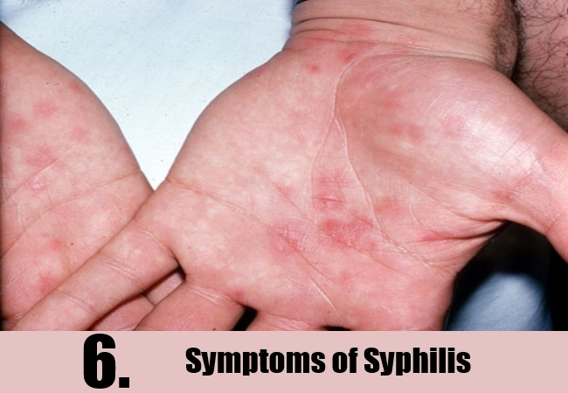

Slide 71
syphilis
Flu-like symptoms
Swollen lymph glands in neck, armpit or groin
Sore throat
Headaches
Fatigue
Internal organ damage (brain, nerves, eyes, heart, blood vessels, liver, bones and joints)
Loss of motor skills
Paralysis
Numbness
Gradual blindness
Dementia
Mental illness

Slide 75
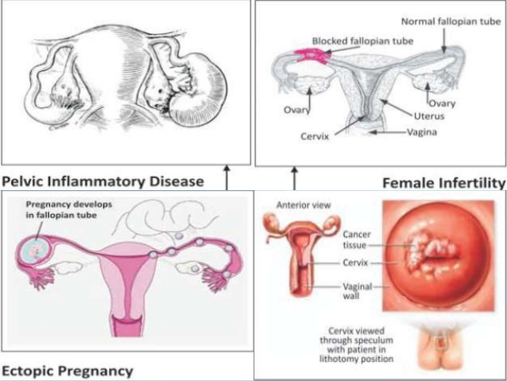

Slide 76
Genital warts
Genital warts are soft growths that appear on the genitals. They’re a sexually transmitted infection (STI) caused by certain strains of the human papilloma virus (HPV).
Genital warts can cause pain, discomfort, and itching. They’re especially dangerous for women because some types of HPV can also cause cancer of the cervix and vulva.
HPV is the most common of all STIs. Men and women who are sexually active are vulnerable to complications of HPV, including genital warts.

Slide 83
END OF CHAPTER

